Slide 1
Analysis of the Housing Market in Two US Cities from 2020-2022
By Real Estate Investment Group

Slide 2
Real Estate Investment Group Members
Nikhil Muthuvenkatesh- Intermediate level of programming in Python, background in sales/engineering to help market the final product, some knowledge of the real estate market
Rohan Ukkalam - Intermediate level of programming in Python, OOP, and Machine Learning. Some experience with programming in Java, C, and SQL.
Seyi Oyesiku - Intermediate level python programmer, my background is computer networking and supply chain logistics. Other familiar programming languages include SQL, R, and Python.
Luqing Qi - Intermediate level Python programmer, my working experience comes from the healthcare industry.

Slide 3
Project Goal
The goal of this project to create a model that is able to accurately predict housing pricing in the cities of New York and Philadelphia by using the real estate data that shows pricing from the start of the pandemic in 2020 to September 2022
We want to study how volatile the real estate market was during this time period, and use that to try to predict what housing pricing will look like in the future.
For our mortgage dataset, we are trying to decide the most important indicators influence the interest rate and interest amount
We will be using several machine learning models from SKLearn to perform our predictions: Logistic Regression, Decision Tree, and Neural Network, as well as KNN and K-Means.

Slide 4
Accomplishments
We have:
Acquired and pre-processed all our data from a series of reliable sources.
Filtered the entire data down to two cities in the east coast, which are New York and Pennsylvania.
Analysed the real estate market in both cities, making use of selected key variables such as pricing, Square footage, number of bathrooms, and most importantly location. All which have provided substantial insight in our analysis so far.
We are seeking to make use of a couple of machine learning models, that we believe will further aid in our final predictions.
All of our work including this presentation are uploaded to this github repository: https://github.com/Unlessitoldyou/DSCI-Capstone1

Slide 5
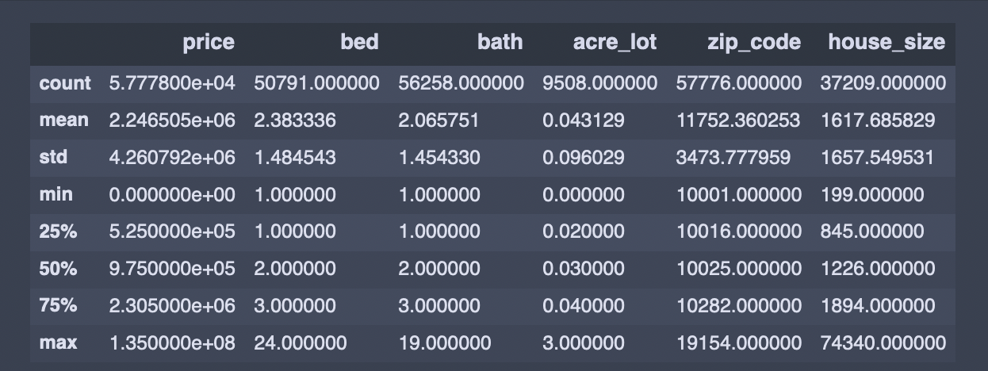
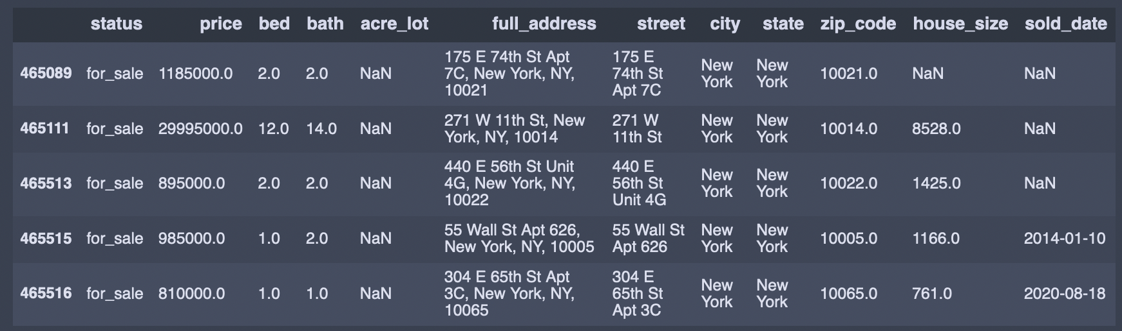
Current Data
This a snapshot of the realtor dataset we are using that shows all the columns we are working with.

Slide 6
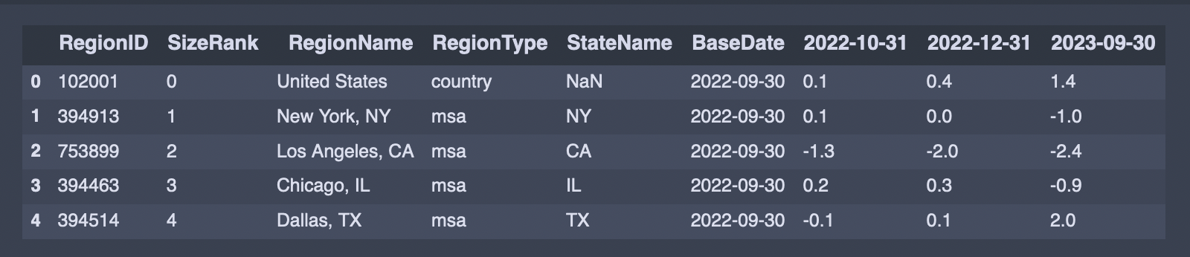
Current Data
We have also been using the Zillow Home Value Index data.

Slide 7
Loan-level Public-Use Databases (PUDBs)
Supervised Learning
Target Variable: Interest amount, Interest rate
We are trying to find the most important variables influence the Interest rate and amount
Potential Methods:
Regression Model, Tree Based Model,Neural Network, KNN
Unsupervised Learning
We are trying to find potential relationship in the mortgage borrower. For example: race group, income level.
Potential Method:
Clustering analysis

Slide 8
Rolling Sales Data at NYC
Supervised Learning
Target Variable: Sales Price
We trying to find the most important variables influence the sales price in the New York City
Potential Method :
Regression Model, Tree Based Model,Neural Network, KNN
Unsupervised Learning
We trying to find potential relationship in year of build and square footage
Potential Method:
K-Means

Slide 9
Possible Models
At the moment we are looking into several machine models to use for the project. To do this, we first contextualized the nature of our problem: We want to predict future prices of real estate listings.
This is a time series problem. Time series data refers to data which is ordered by time, most often evenly spaced intervals of time. Time series forecasting refers to the use of a model to predict future values based on previously observed values, which is exactly what we are attempting to do.
With this in mind, what are some of the machine learning models we are considering?

Slide 10
Logistic Regression
Logistic Regression is almost always the first model that comes to the mind when working on classification models. As it is a type of statistical model most often used for classification and predictive analytics, a logistic regression model is well suited for our project. It is a relatively simple machine learning model, both in terms of mechanisms and implementation. Despite its simplicity, it often yields good results.

Slide 11
Decision Tree
A decision tree is a non-parametric supervised learning algorithm, often used for classification and regression tasks. It is its usage for classification tasks that interest us. A proper decision tree would produce a neat visualization which we could use for the final product. This model requires less effort for data preparation, and doesn’t care about normalizing and scaling of data.
If the Decision Tree does not yield adequate results, we are considering a Random Forest model as a substitution, as it can efficiently solve problems if there are any problems in the decision tree model like overfitting

Slide 12
Neural Networks
A neural network allows us to be able to set weights for each of our predictor variables, so we may need to determine what our most important variables are and how we want to assign these weights. We will be trying to evaluate how effective this model was by measuring the Mean Square Error (MSE).
Recurrent Neural Networks, or RNNs is a neural network used in the processing of sequential data such as time series forecasting or natural language processing, which makes it well-suited for the purpose of our project.
Recurrent Neural Networks are geared specifically for time series problems, and allow us to use information from prior inputs to affect the current inputs and outputs.

Slide 13
K-nearest Neighbors KNN
K-nearest Neighbors is a supervised machine learning algorithm that is used to solve classification and regression problems.
We want to use KNN algorithm help us understand individual’s interest rate by comparing them with the ones with similar characteris.
One of the most significant advantage of using the KNN algorithm is that there’s no need to build a model or tune several parameters. KNN doesn’t work well if there are too many features. We could apply principal component analysis (PCA) to deal with this drawback.

Slide 14
K-Mean
K-means clustering is an unsupervised clustering algorithm that groups data into a K number of clusters.
We are considering applying the K-Mean method in our Mortgage Dataset and NYC Rolling Sales datasets to discover underlying patterns to help us discover with direction we should head with our final product.

Slide 15
Next Steps
We need to look into what kind of a decision tree we would like to implement for this study, and this will require some further research.
Now that our data is preprocessed and explored, we need to give it some further processing with respect to the models we plan to use, such as feature selection and applying an appropriate feature scaler
We need to begin splitting our data into training and test sets in preparation for training each of our models with the training set and predicting with the test set.
Once we know how well each model has performed, we will be able to asses which model was best suited for predicting real estate pricing, and we can begin to use that model to try to predict how housing pricing will be this year.

Slide 16
Thank You

